Slide 1
Asteroid Hub
Yusuf Shaik

Slide 2

What did I create?
Researched orbital mechanics, and developed an application that accesses NASA’s NEO API and dynamically draws the orbital diagram for asteroids that are approaching earth, embedding them into the web application. Provided a simple user interface to increase availability.
SMS-based subscription service that texts users as soon as an asteroid that NASA has classified as “hazardous” is discovered.

Slide 3

Purpose
Audience
Challenge: Hey! What are you looking at?
Browse orbital diagrams of near-earth asteroids
SMS subscription service for hazardous asteroids
Target Audience: Space enthusiasts/Researchers
JPL website gives in-depth information, might be too much info for the average user
Researchers might like to see the information at a quick glance

Slide 4
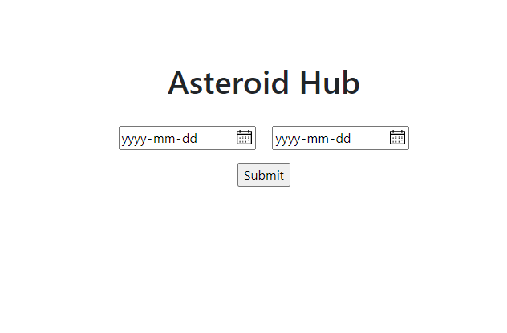
Initial Screen
Search by asteroid’s close approach date to earth
Plan: Add more search criteria (size, distance, etc.)

Slide 5
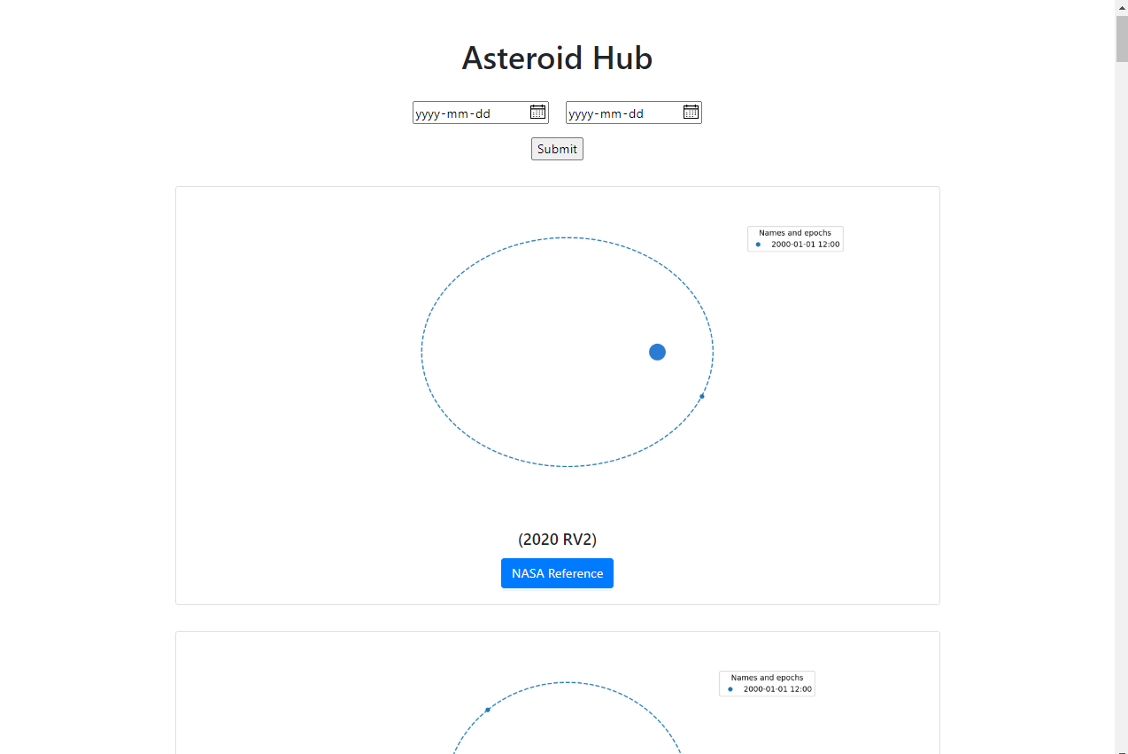
Asteroid Orbitals
Graphs Generated dynamically using matplotlib/poliastro, then embedded into the website
Official Jet Propulsion Laboratory Reference available for each diagram
Plan: Add hazardous asteroids to the top of the page. Add the ability to sort data once presented

Slide 6
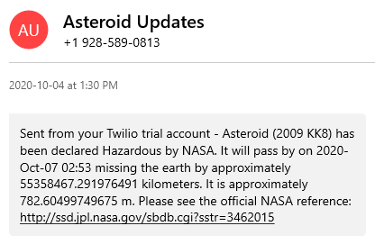
Hazardous Asteroid Subscription Service
Set up script on server to constantly check for new hazardous asteroids. Texts will be sent out as soon as one is found.
Plan: Create webpage to register new users. Add email list

Slide 7
Future Additions
Switch to interactive 3D diagrams embedded within the website. Compact view should still be available
Create an interactive view (2D and 3D) depicting all asteroids and their orbits in a single diagram (This was my original plan for the hackathon)
Expand to more platforms (mobile, desktop, widgets)
Option to filter data by more criteria

